Slide 1
No code! Community Contributions without Curly Braces
Nathen Harvey

Slide 2
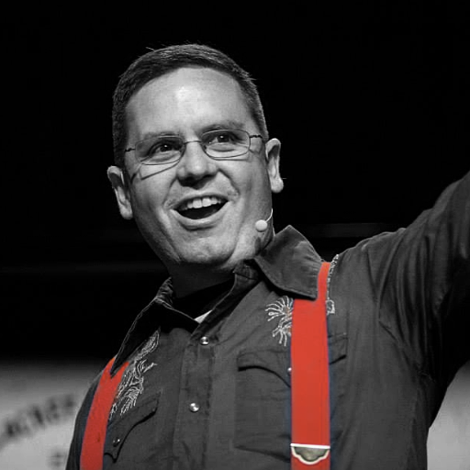

Nathen Harvey
VP, Community Development at Chef
Co-host of the Food Fight Show
Co-organizer of DevOpsDC meetup
Occasional farmer – http://bit.ly/farmer-nathen
Love Eggs – http://eggs.chef.io
@nathenharvey
nharvey@chef.io

Slide 3
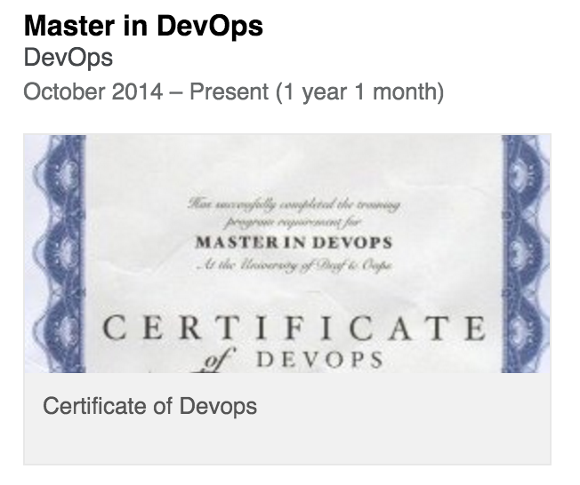
Nathen Harvey
VP, Community Development at Chef
Co-host of the Food Fight Show
Co-organizer of DevOpsDC meetup
Occasional farmer – http://bit.ly/farmer-nathen
Love Eggs – http://eggs.chef.io
@nathenharvey
nharvey@chef.io

Slide 4
Open Source
Have you contributed to an open source project?

Slide 5
Open Source
Have you contributed to an open source project?
Do you want to?

Slide 6
Which version control system do your use?

Slide 7
Which version control system do your use?
cp foo foo.bak

Slide 8
Which version control system do your use?
cp foo foo.bak
cp foo{,.`date +%Y%m%d%H%M`}

Slide 9
Which version control system do your use?
cp foo foo.bak
cp foo{,.`date +%Y%m%d%H%M`}
cp foo{,.`date +%Y%m%d%H%M`-`$USER`}

Slide 10
Contributing to Open Source

Slide 11
Why do YOU want to contribute?

Slide 12
What is stopping YOU?

Slide 13
Fear of an Open Source Planet
I don’t know how to write code.
I’m just getting started, what could I possibly contribute?
My code isn’t good enough.
What am I allowed to share?
Do I need a license?
Do I have to complete a contributor license agreement?

Slide 14
Contributing More Than Code

Slide 15







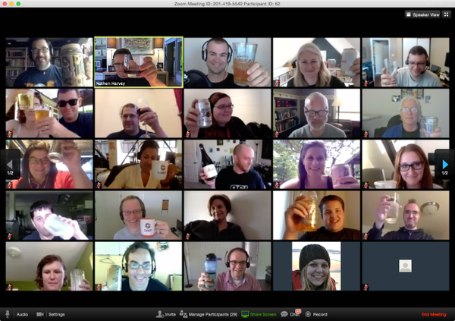



Knowledge Share

Slide 16

Meetups
Listen
Learn
Present
Interact

Slide 17

Host Meetups

Slide 18


Slide 19
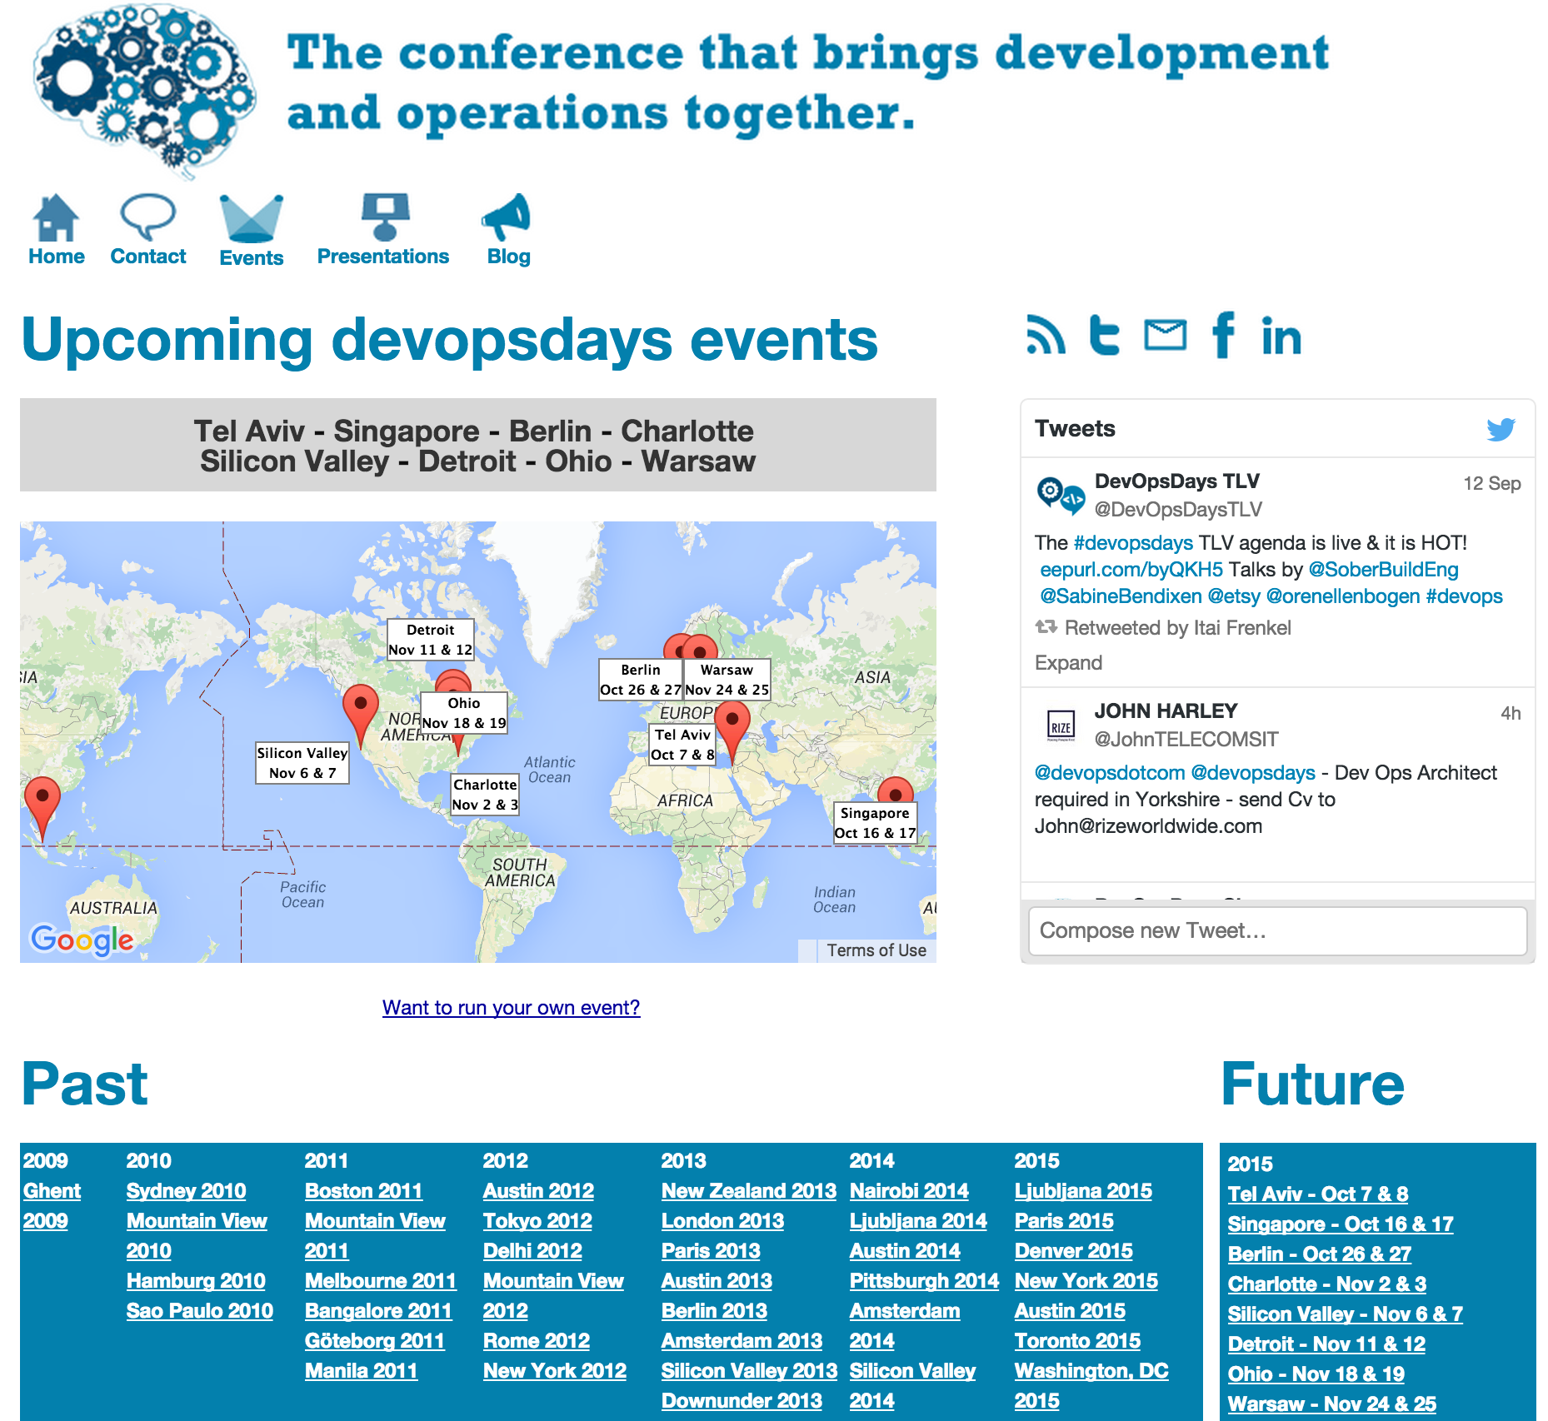

Slide 20
Contributing on GitHub

Slide 21
Contributing on GitHub
Issues

Slide 22
Contributing on GitHub
Issues
Wiki

Slide 23
Contributing on GitHub
Issues
Wiki
Pull Requests

Slide 24
The mechanics of contributing
Find a project you love
Fork the project
Configure a remote for your fork
https://help.github.com/articles/configuring-a-remote-for-a-fork/
Stay in sync with the upstream repository
https://help.github.com/articles/syncing-a-fork/
Follow the project’s contributing guidelines
Create a branch
Open a Pull Request

Slide 25
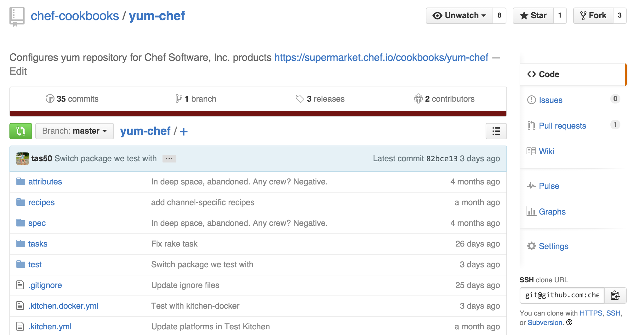
A project I love

Slide 26
A project I love
https://github.com/nathenharvey/contributing-to-open-source

Slide 27
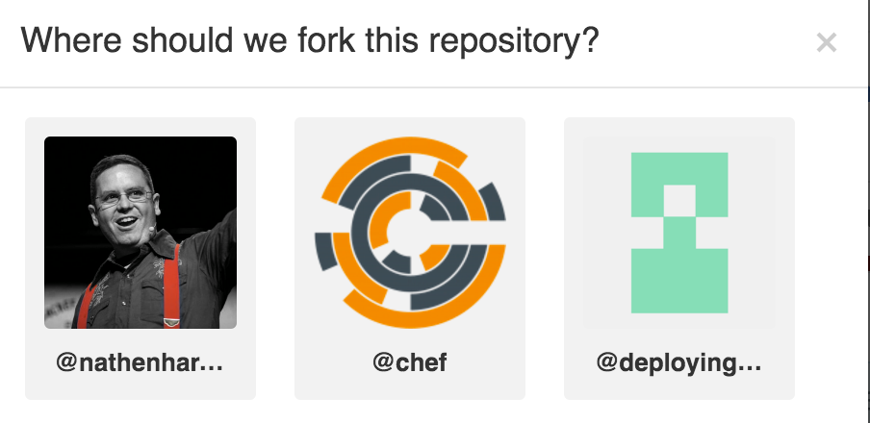
Fork the project

Slide 28
Clone your fork
$ git clone git@github.com:nathenharvey/yum-chef.git
Cloning into 'yum-chef'...
remote: Counting objects: 158, done.
remote: Compressing objects: 100% (20/20), done.
remote: Total 158 (delta 5), reused 0 (delta 0), pack-reused 132
Receiving objects: 100% (158/158), 28.28 KiB | 0 bytes/s, done.
Resolving deltas: 100% (58/58), done.
Checking connectivity... done.

Slide 29
Configure a remote
$ git remote add upstream https://github.com/chef-cookbooks/yum-chef.git

Slide 30
Sync with remote
$ git fetch upstream
From https://github.com/chef-cookbooks/yum-chef
* [new branch] master -> upstream/master

Slide 31
Sync with remote
$ git merge upstream/master
Already up-to-date.

Slide 32
Checkout a local branch
$ git checkout --track -b link_readme upstream/master
Branch link_readme set up to track remote branch master from upstream.
Switched to a new branch 'link_readme'

Slide 33
Push the new branch
$ # edit the file you want to change
$ git add [the file(s) you changed]
$ git commit –m ‘a really good commit message’
$ git push origin
Counting objects: 3, done.
Delta compression using up to 8 threads.
Compressing objects: 100% (3/3), done.
Writing objects: 100% (3/3), 344 bytes | 0 bytes/s, done.
Total 3 (delta 2), reused 0 (delta 0)
To git@github.com:nathenharvey/yum-chef.git
* [new branch] link_readme -> link_readme

Slide 34
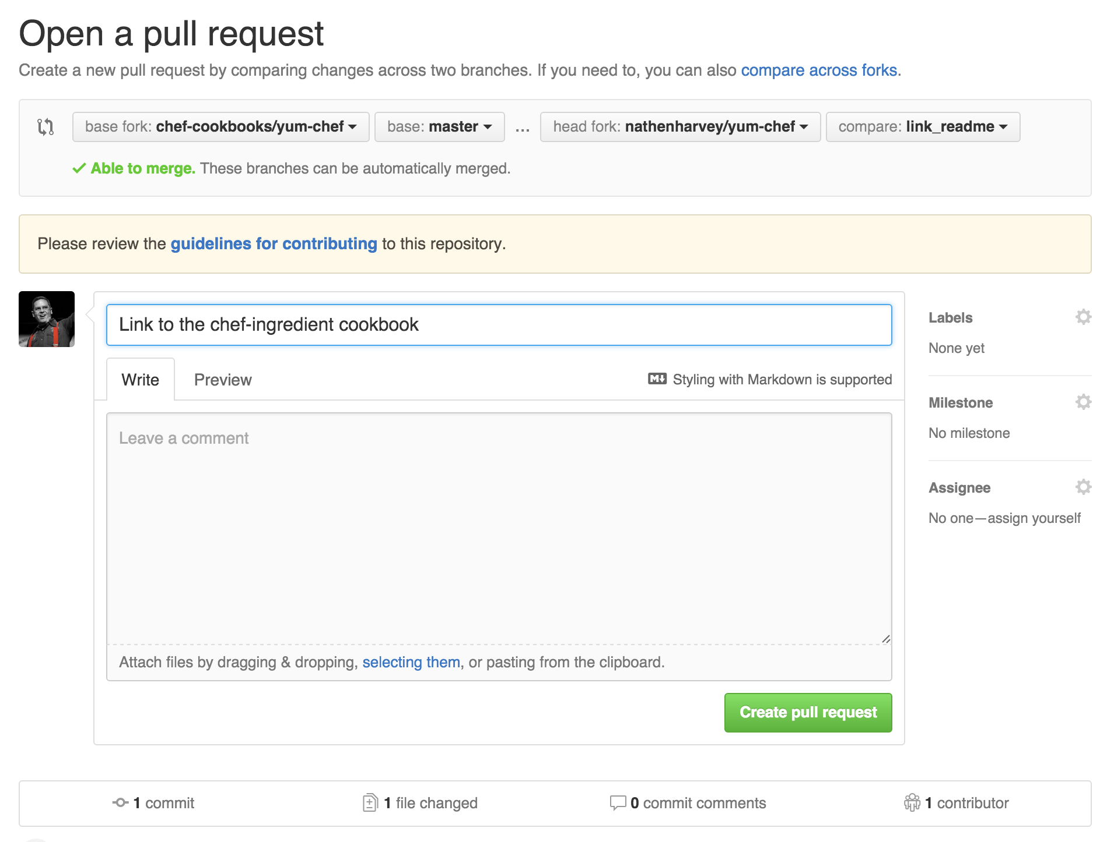
Open Pull Request

Slide 35
Congratulations!
You have submitted a pull request.

Slide 36
License Concerns

Slide 37
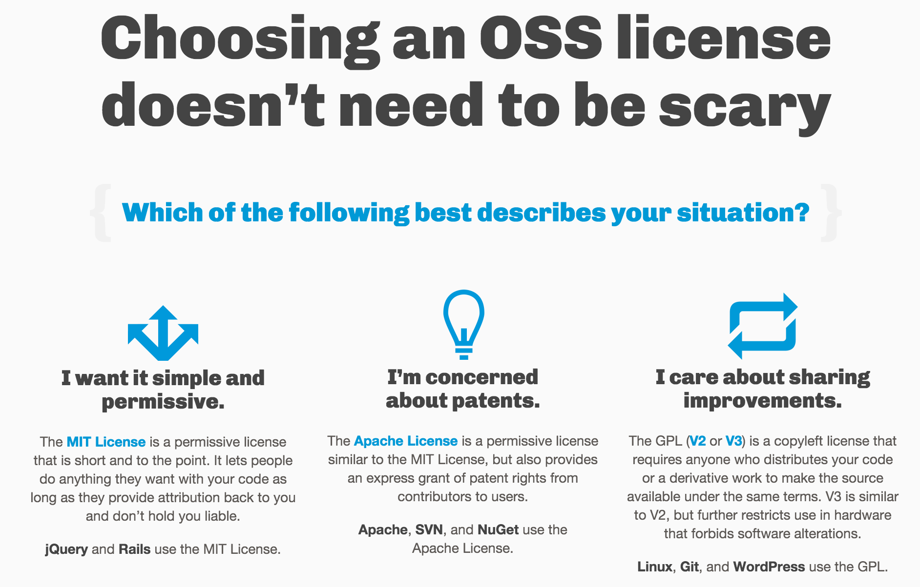

Slide 38
http://choosealicense.com/

Slide 39
What questions do you have?
Ask me anything!
@nathenharvey
Thank you!

